Slide 1
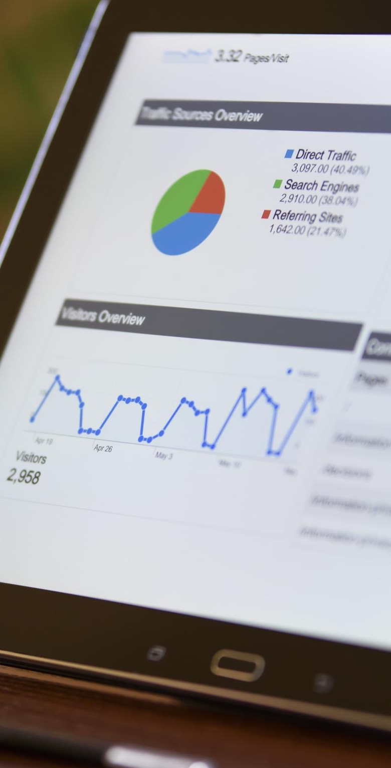

FULLSTACK INTENSIVE BOOTCAMP
Data Analyst
Kickstart Career as Data Analyst
Oleh: Muhammad Wahfiuddin Pradiwa
JOIN THE BEST UPSKILLING COMMUNITY
WITH ME at myskill.id/bootcamp
MINI PORTOFOLIO

Slide 2

Describe based on your understanding!
Why do companies need data?
What’s the difference between data engineer, analyst, and scientist?
Read this article:
https://gibranhuzaifah.medium.com/habits-of-being-happy-aa7acc7dc0f6
Companies need data for many purpose. Data could give performance summary for the company, data could improve companies sales by identify the customers, data could show which division/process is weak.
Data Engineer responsible on data management that focus in data mining, data cleaning and data storage. Data analyst responsible on data interpretation and data utilization, solve business problem based on data. Data scientist responsible on machine learning, data automation, research which focus on programming.
#RintisKarirImpian

Slide 3
Let’s study these cases
Raphael is a mobile vegetables seller. Everyday he sells a lot of veggies to the moms in many housing complex. Can Raphael step up his game to be a data-driven vegetables seller? If yes, how can he do it?
Shaenette loves baking so much that she considers to sell her pastries online. Do you think she needs to be data-driven? What are your advices to her?
Haji Endo is the head chief of one of the largest charity in Yokohama. Fundraising and distribution in traditional fashion have been running for years, but Haji Endo wants to do a breakthrough: to serve the donors and recipients more personally. What can he do?
#RintisKarirImpian

Slide 4
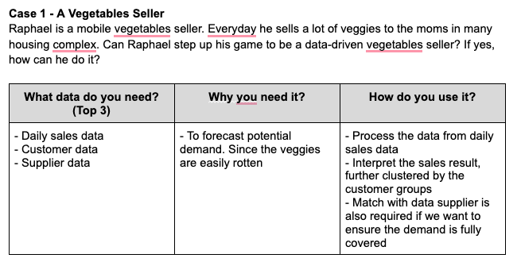
If you become a data analyst.
What the data that you need?
Why?
And how?
#RintisKarirImpian

Slide 5
Study Cases Docs
Case 2 - Baking Store Shaenette loves baking so much that she considers selling her pastries online. Do you think she needs to be data-driven? What are your advice to her?
What data do you need? (Top 3) | Why you need it? | How do you use it?
Baking trends Customer data Sales data | To follow the trends Market segmentation | Catch up with trends from trend data so we can create updated pastries Analyze sales performance from sales data Customer group segmentation for adjust pastries decoration
Case 3 - Charity Industry
Haji Endo is the head chief of one of the largest charity in Yokohama. Fundraising and distribution in traditional fashion have been running for years, but Haji Endo wants to do a breakthrough: to serve the donors and recipients more personally. What can he do?
What data do you need? (Top 3) | Why you need it? | How do you use it?
Recipients data Donors data Fashion data | To know what recipients need To know what goods was donored | Match with data recipients and donors Adjust goods that donored so it can make more personally
#RintisKarirImpian

Slide 6

Follow me!
Instagram :
Twitter :
LinkedIn :
Bootcamp Data Analysis
by @myskill.id

